Slide 1
Chapter 13
Generics
李晔锋

Slide 2
Key Skills & Concepts
Understand the benefits of generics
Create a generic class
Apply bounded type parameters
Use wildcard arguments
Apply bounded wildcards
Create a generic method
Create a generic constructor
Create a generic interface
Utilize raw types
Apply type inference with the diamond operator
Understand erasure
Avoid ambiguity errors
Know generics restrictions

Slide 3
Generics（泛型） Fundamentals
At its core, the term generics means parameterized types. Parameterized types are important because they enable you to create classes, interfaces, and methods in which the type of data upon which they operate is specified as a parameter. A class, interface, or method that operates on a type parameter is called generic, as in generic class or generic method.

Slide 4
A Simple Generics Example
public class Gen<T> {
T ob;
Gen(T o){
ob = o;
}
public T getOb() {return ob;}
public void showType() {
System.out.println("Type of T is " + ob.getClass().getName());
}
}
Definition format:
access-modifier class classname<T>
Here, T can be any capitalized letter representing any class type inherited from Object. Thus the object of T can call any method defined in Object.

Slide 5
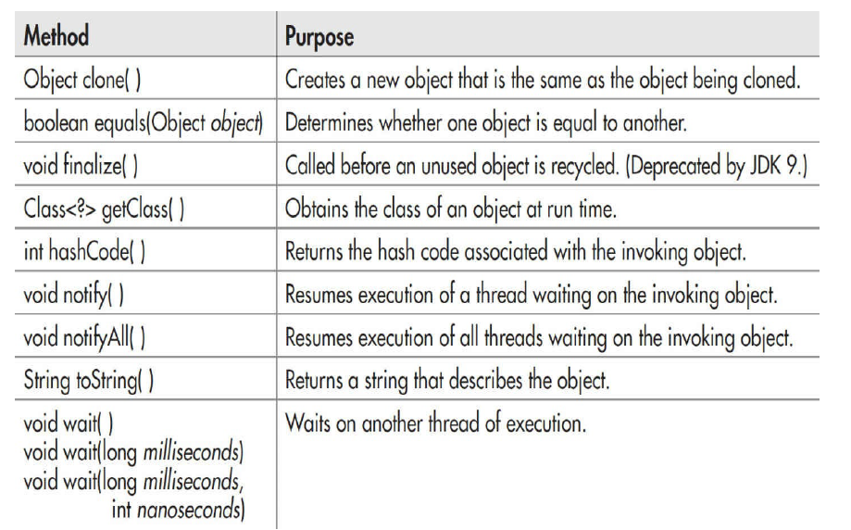
Methods of The Object Class

Slide 6
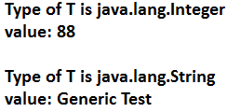
A Simple Generics Example
public class GenDemo {
public static void main(String[] args) {
// TODO Auto-generated method stub
Gen<Integer> iOb = new Gen<Integer>(88);
iOb.showType();
int v = iOb.getOb();
System.out.println("value: " + v);
System.out.println();
Gen<String> strOb = new Gen<String>("Generic Test");
strOb.showType();
String str = strOb.getOb();
System.out.println("value: " + str);
}
}
Usage of Generics:
Specify a concrete subclass of Object, such as Integer, String, etc, instead of T.

Slide 7
Generics Work Only with Reference Types
When declaring an instance of a generic type, the type argument passed to the type parameter must be a reference type. You cannot use a primitive type, such as int or char. For example, the following usage is incorrect:
Gen<int> intOb = new Gen<int>(53);

Slide 8
Generic Types Differ Based on Their Type Arguments
A key point to understand about generic types is that a reference of one specific version of a generic type is not type-compatible with another version of the same generic type. For example, the following statements are incorrect:
Gen<Integer> iOb = new Gen<Intger>(100);
Gen<String> strOb = new Gen<String>(“50”);
strOb = iOb; //Error!

Slide 9
A Generic Class with Two Type Parameters
You can declare more than one type parameter in a generic type. To specify two or more type parameters, simply use a comma-separated list. Such as
class TwoGen<T,V>

Slide 10
public class TwoGen<T, V> {
T ob1;
V ob2;
TwoGen(T o1, V o2){
ob1 = o1;
ob2 = o2;
}
T getOb1() {return ob1;}
V getOb2() {return ob2;}
void showTypes() {
System.out.println("Type of T is " + ob1.getClass().getName());
System.out.println("Type of V is " + ob2.getClass().getName());
}
}

Slide 11
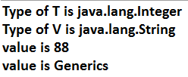
public class SimpGen {
public static void main(String[] args) {
// TODO Auto-generated method stub
TwoGen<Integer,String> tgObj = new TwoGen<Integer,String>(88,"Generics");
tgObj.showTypes();
int v = tgObj.getOb1();
System.out.println("value is " + v);
String str = tgObj.getOb2();
System.out.println("value is " + str);
}
}

Slide 12
Bounded Types
When specifying a type parameter, you can create an upper bound that declares the superclass from which all type arguments must be derived. This is accomplished through the use of an extends clause when specifying the type parameter, as shown here:
<T extends superclass>
This specifies that T can be replaced only by superclass, or subclasses of superclass. Thus, superclass defines an inclusive, upper limit, and T is able to call the methods defined in superclass.

Slide 13
public class NumericFns<T extends Number> {
T num;
NumericFns(T n){
num = n;
}
double reciprocal() {
return 1 / num.doubleValue();
}
double fraction() {
return num.doubleValue() - num.intValue();
}
}

Slide 14
public class BoundsDemo {
public static void main(String[] args) {
// TODO Auto-generated method stub
NumericFns<Integer> iOb = new NumericFns<Integer>(5);
System.out.println("Reciprocal of iOb is " + iOb.reciprocal());
System.out.print("Fraction component of iOb is ");
System.out.println(iOb.fraction());
NumericFns<Double> dOb = new NumericFns<Double>(5.25);
System.out.println("Reciprocal of dOb is " + dOb.reciprocal());
System.out.print("Fraction component of dOb is ");
System.out.println(dOb.fraction());
}
}

Slide 15
Using Wildcard（通配符） Arguments
Background: Consider the following requirement:
NumericFns<Double> dOb = new NumericFns<Double>(1.25);
NumericFns<Float> fOb = new NumericFns<Float>(-1.25f);
You are asked to implement an absEqual() method, calling like dOb.absEqual(fOb), and returning a boolean value. You may probably do it like this:
boolean absEqual(NumericFns<T> another) {
if(Math.abs(num.doubleValue()) == Math.abs(another.num.doubleValue()))
return true;
else
return false;
}

Slide 16
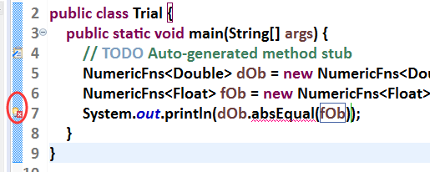
Using Wildcard Arguments
However, an compile error will occur in main, indicating that the arguments must be compatible when doing absEqual().

Slide 17
Using Wildcard Arguments
The solution is very simple, just change the definition of absEqual() slightly using the wildcard(?).
boolean absEqual(NumericFns<?> another) {
if(Math.abs(num.doubleValue()) == Math.abs(another.num.doubleValue()))
return true;
else
return false;
}
Here, NumericFns<?> matches any type of NumericFns object, allowing any two NumericFns objects to have their absolute values compared.

Slide 18
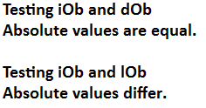
public class WildCardDemo {
public static void main(String[] args) {
// TODO Auto-generated method stub
NumericFns<Integer> iOb = new NumericFns<Integer>(6);
NumericFns<Double> dOb = new NumericFns<Double>(-6.0);
NumericFns<Long> lOb = new NumericFns<Long>(5L);
System.out.println("Testing iOb and dOb");
if(iOb.absEqual(dOb))
System.out.println("Absolute values are equal.");
else
System.out.println("Absolute values differ.");
System.out.println();
System.out.println("Testing iOb and lOb");
if(iOb.absEqual(lOb))
System.out.println("Absolute values are equal.");
else
System.out.println("Absolute values differ.");
}
}

Slide 19
Bounded Wildcards
public class UseBoundedWildCard {
static void test(Gen<? extends A> ob) {
System.out.println(ob.getClass().getName());
}
public static void main(String[] args) {
// TODO Auto-generated method stub
A a = new A();
B b = new B();
C c = new C();
D d = new D();
Gen<A> w = new Gen<A>(a);
Gen<B> w2 = new Gen<B>(b);
Gen<C> w3 = new Gen<C>(c);
Gen<D> w4 = new Gen<D>(d);
test(w);
test(w2);
test(w3);
//test(w4);
}
}
class A {}
class B extends A {}
class C extends A {}
class D {}
class Gen<T> {
T ob;
Gen(T o){
ob = o;
}
}

Slide 20
Bounded Wildcards
The following parameter in the method test has used the bounded wildcard.
static void test(Gen<? extends A> ob)

Slide 21
Generic Methods
A very simple demo
public class SimpleGenericMethodDemo {
public static <T> void print(T t){
System.out.println(t.toString());
}
public static void main(String[] args) {
// TODO Auto-generated method stub
Integer i1 = 100;
String s2 = "Hello";
char[] c = {'你','好’};
print(i1);
print(s2);
print(c);
}
}

Slide 22
A More Complicated Demo for Generic Methods
public class GenericMethodDemo {
public static <T extends Comparable<T>, V extends T> boolean
arrayEquals(T[] x, V[] y) {
if(x.length != y.length) return false;
for(int i = 0; i < x.length; i++)
if(!x[i].equals(y[i])) return false;
return true;
}
public static void main(String[] args) {
// TODO Auto-generated method stub
Integer nums[] = {1,2,3,4,5};
Integer nums2[] = {1,2,3,4,5,6};
Integer nums3[] = {2,3,4,5,6,7};
Double nums4[] = {0.1,0.2,0.3,0.4,0.5};
System.out.println(arrayEquals(nums,nums));
System.out.println(arrayEquals(nums,nums2));
System.out.println(arrayEquals(nums,nums3));
//System.out.println(arrayEquals(nums,nums4));
}
}

Slide 23
Generic Methods
public static <T extends Comparable<T>, V extends T> boolean arrayEquals(T[] x, V[] y)
(1)
(2)
(3)
(4)
(5)
(1) Access right.
(2) Specify the method is a generic method, and the Generic symbols used in the method. Implementing an interface will also use the “extends” keyword.
(3) The return value, also can be a generic symbol.
(4) Method name.
(5) Method parameters, should be consistent with (2).

Slide 24
Generic Constructors
A constructor can be generic, even if its class is not.

Slide 25

public class Summation {
private int sum;
<T extends Number>Summation(T arg){
sum = 0;
for(int i = 0; i < arg.intValue(); i++)
sum += i;
}
int getSum() {return sum;}
}
public class GenConsDemo {
public static void main(String[] args) {
// TODO Auto-generated method stub
Summation ob = new Summation(4.8);
Summation ob2 = new Summation(6);
Summation ob3 = new Summation(11.2f);
System.out.println(ob.getSum());
System.out.println(ob2.getSum());
System.out.println(ob3.getSum());
}
}

Slide 26
Generic Interfaces
Generic interfaces are specified just like generic classes.
interface interfacename<T>
In general, if a class implements a generic interface, then that class must also be generic, at least to the extent that it takes a type parameter that is passed to the interface. For example:
class MyClass<T> implements Containment<T>

Slide 27
Generic Interfaces
The following is wrong:
class MyClass implements Containment<T> { // Wrong!
However, if a class implements a specific type of generic interface, then the implementing class does not need to be generic.
class MyClass implements Containment<Double> { // OK

Slide 28
Generic Interfaces
As you might expect, the type parameter(s) specified by a generic interface can be bounded. This lets you limit the type of data for which the interface can be implemented.
interface Containment<T extends Number>
However, the following is wrong.
class MyClass<T extends Number> implements Containment<T extends Number > {
You should write it like:
class MyClass<T extends Number> implements Containment<T> {

Slide 29
Generic Interface Demo
interface Containment<T> {
boolean contains(T o);
}
public class MyClass<T> implements Containment<T> {
T[] arrayRef;
MyClass(T[] o){
arrayRef = o;
}
@Override
public boolean contains(T o) {
// TODO Auto-generated method stub
for(T x: arrayRef) {
if(x.equals(o)) return true;
}
return false;
}
}

Slide 30
Generic Interface Demo
public class GenIfDemo {
public static void main(String[] args) {
// TODO Auto-generated method stub
Integer x[] = {1,2,3};
Double y[] = {0.4,0.5,0.6};
String z[] = {"Hello","World","你好"};
MyClass<Integer> ob = new MyClass<Integer>(x);
MyClass<Double> ob2 = new MyClass<Double>(y);
MyClass<String> ob3 = new MyClass<String>(z);
System.out.println(ob.contains(5));
System.out.println(ob2.contains(0.5));
System.out.println(ob3.contains("你好"));
}
}

Slide 31
Raw Types and Legacy Code
Java allows a generic class to be used without any type arguments. This creates a raw type for the class. This raw type is compatible with legacy code,

Slide 32
public class Gen<T> {
T ob;
Gen(T o){ob = o;}
T getOb() {return ob;}
}
public class RawDemo {
public static void main(String[] args) {
// TODO Auto-generated method stub
Gen<Integer> iOb = new Gen<Integer>(88);
Gen<String> strOb = new Gen<String>("Generic Test");
Gen raw = new Gen(98.6);
double d = (Double)raw.getOb();
System.out.println("value " + d);
int i = (Integer)raw.getOb();
strOb = raw;
String str = strOb.getOb();
raw = iOb;
d = (Double)raw.getOb();
}
}

Slide 33
Raw Types and Legacy Code
If you does not specify the type parameter of a generic class, then a raw type is created, such as follows:
Gen raw = new Gen(98.6);
In this case, the type T is automatically specified as Object.
The raw type is unsafe, as you can cast to any other type without a compile error. However, it will cause exception when running the program.
You should limit the use of raw types to those cases in which you must mix legacy code with modern, generic code.

Slide 34
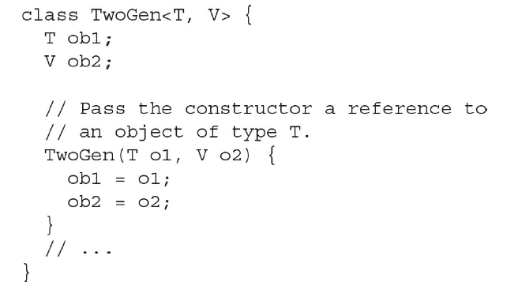
Type Inference with the Diamond Operator
Suppose you have defined the following generic class:

Slide 35
Type Inference with the Diamond Operator
You can shorten the written of initialization as follows:
TwoGen<String,Integer> tgOb = new TwoGen<>(42, “testing”);
The type parameters in the new statement is shortened as “<>”, which is called a diamond operator. It means the parameters are the same as those in the former.

Slide 36
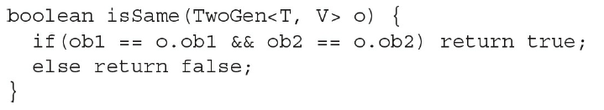
Type Inference with the Diamond Operator
You can shorten the written of method calling as follows:
if(tgOb.isSame(new TwoGen<>(42, "testing"))) System.out.println("Same");

Slide 37
Erasure
When Java compiler transforms your source code into object code, all generic type information is removed (erased). This is called erasure.
It means replacing type parameters with their bound type, which is Object if no explicit bound is specified, and then applying the appropriate casts (as determined by the type arguments) to maintain type compatibility with the types specified by the type arguments.

Slide 38
Ambiguity Errors
The inclusion of generics gives rise to a new type of error that you must guard against: ambiguity. Ambiguity errors occur when erasure causes two seemingly distinct generic declarations to resolve to the same erased type, causing a conflict.

Slide 39
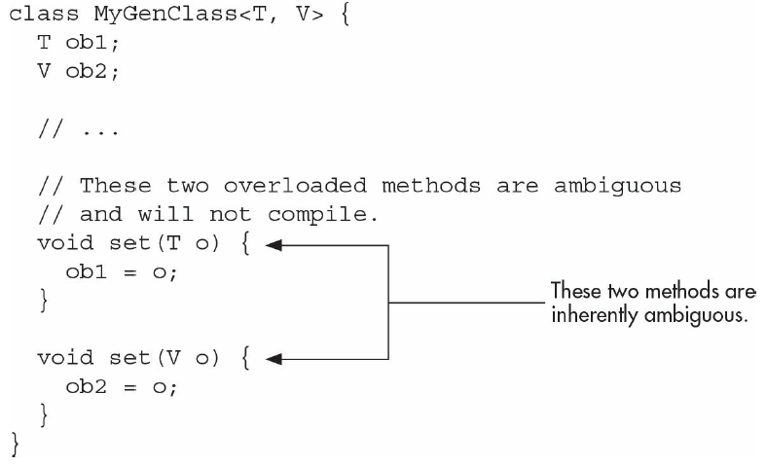
Ambiguity Errors

Slide 40
Some Generic Restrictions
There are a few restrictions that you need to keep in mind when using generics. They involve creating objects of a type parameter, static members, exceptions, and arrays.

Slide 41
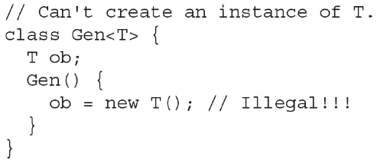
Type Parameters Can’t Be Instantiated

Slide 42
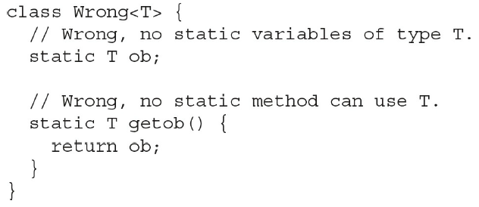
Restrictions on Static Members
No static member can use a type parameter declared by the enclosing class.

Slide 43
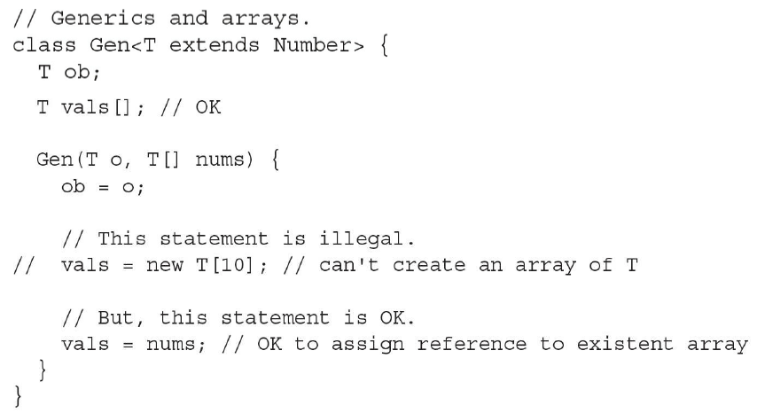
Generic Array Restrictions
First, you cannot instantiate an array whose element type is a type parameter.

Slide 44
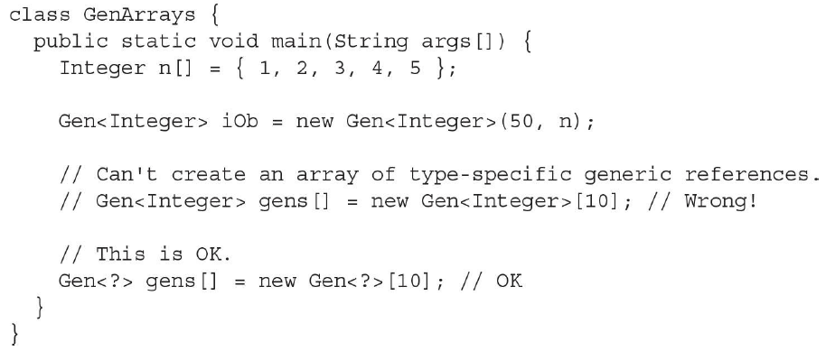
Generic Array Restrictions
Second, you cannot create an array of type-specific generic references.

Slide 45
Generic Exception Restriction
A generic class cannot extend Throwable. This means that you cannot create generic exception classes.

